Slide 1
Big Data Analysis
Spark part 4

Slide 2
Spark 04 – Word Cloud and Inverted Index

Slide 3
Last time… we have learned Tokenization, Stopwords, N-gram, Lemmatization, and stemming, etc.

Slide 4
Lecture Objective
Word Cloud (Tokenization + Stopword + WordCount)
Understand the theory of Inverted Index
Hands-on practice of Inverted Index
Hands-on program to dive into Spark

Slide 5
Word Cloud
A word cloud is a novelty visual representation of text data, typically used to depict keyword metadata (tags) on websites, or to visualize free form text.
The importance of each word is shown with font size or color.
This format is useful for quickly perceiving the most prominent terms to determine its relative prominence.
Bigger term means greater weight.

Slide 6
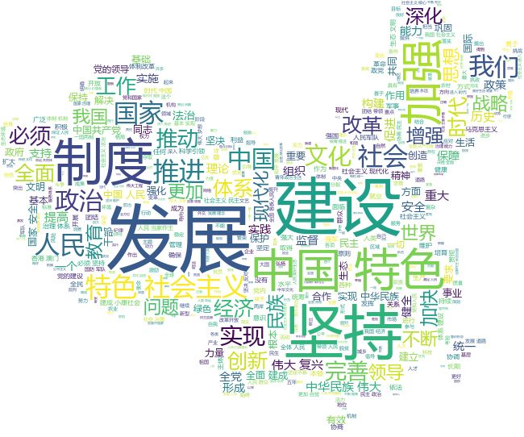
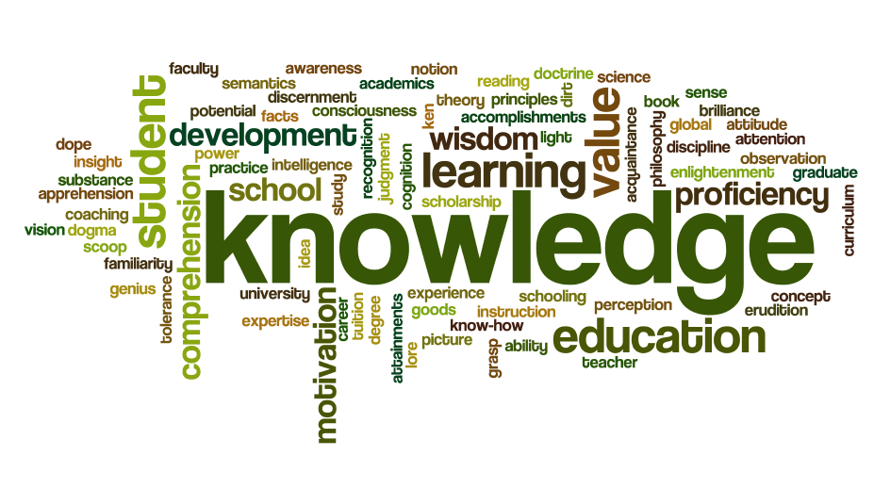
Word Cloud

Slide 7
Word Cloud
For an article, draw a word cloud is pretty easy:
  Tokenization
  WordCount
  Remove stopwords
  Draw a picture
Install wordcloud in jupyter notebook:
pip install wordcloud
Or conda install wordcloud

Slide 8
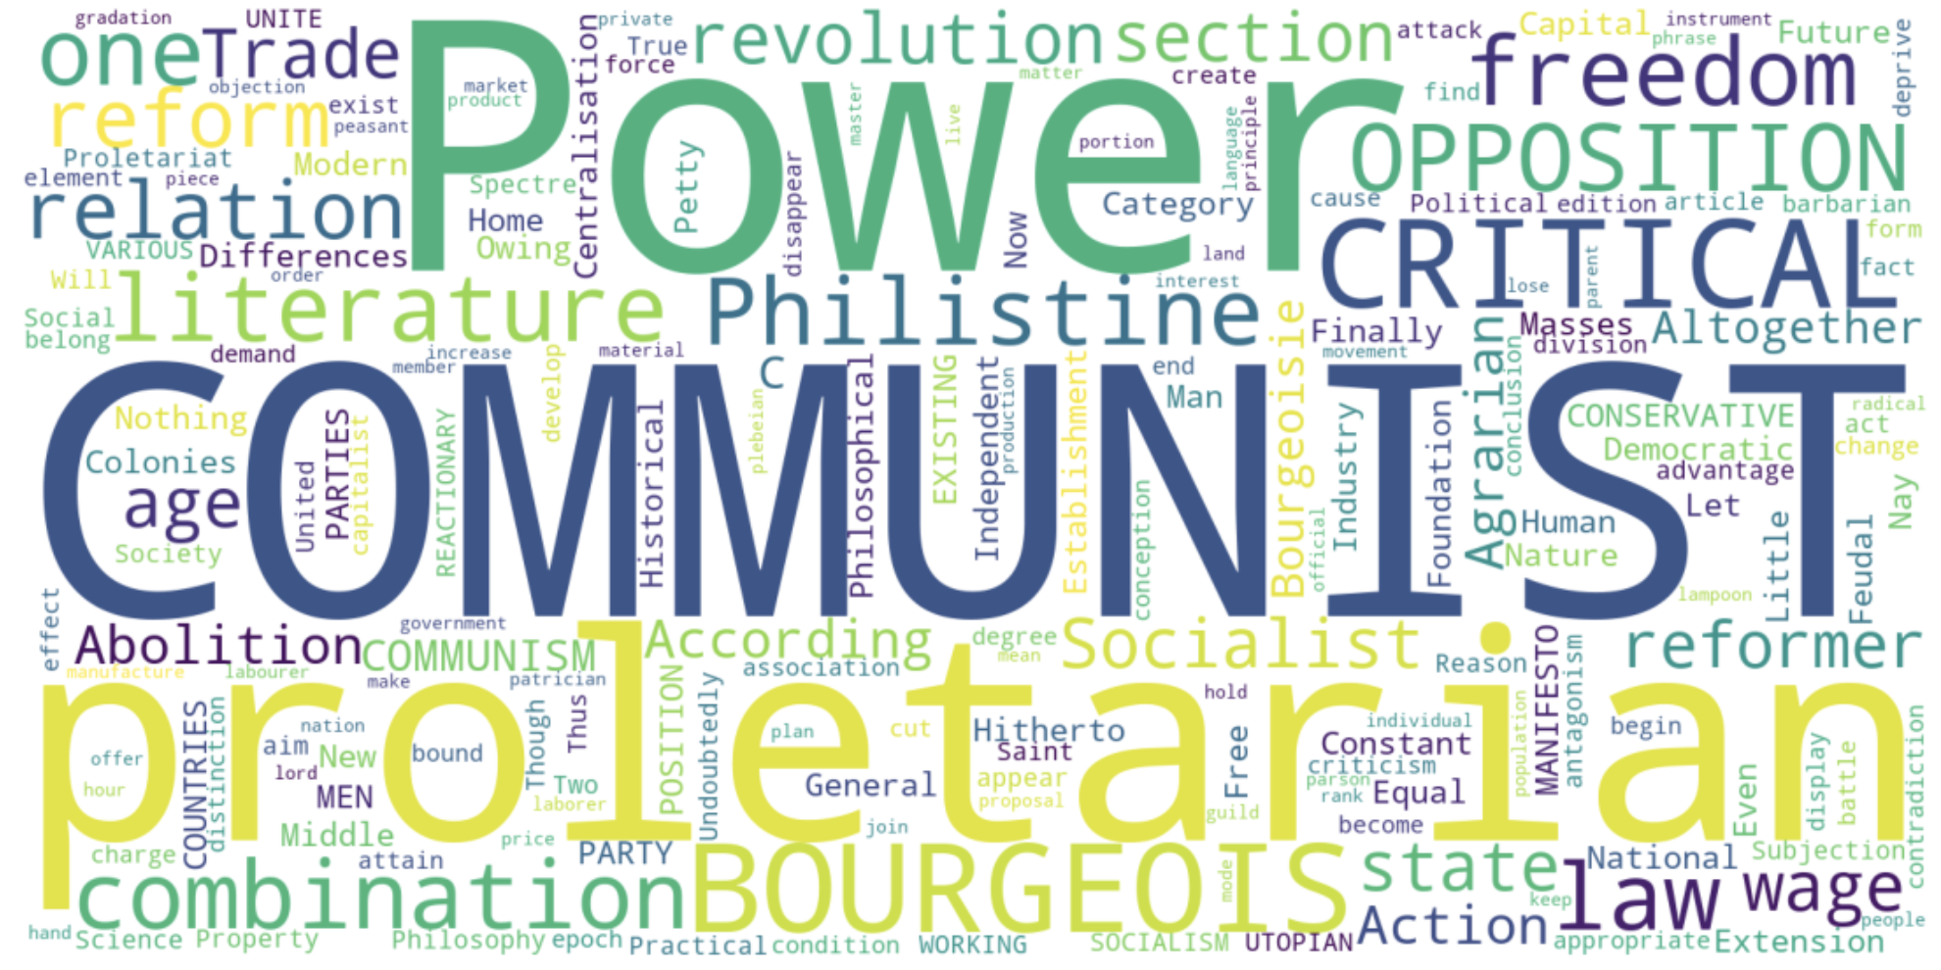
LabS04_1 - Word Cloud
Refer to the code: LabS04_1_WordCloud

Slide 9
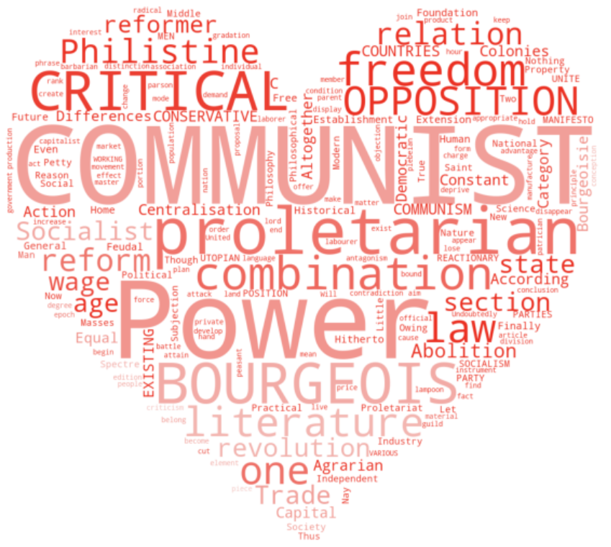
LabS04_1 - Word Cloud
Refer to the code: LabS04_1_WordCloud

Slide 10
Word Cloud
For a Chinese article, draw a word cloud is similar:
  Tokenization, by using a Chinese tokenizer, e.g. jieba
  WordCount
  Remove stopwords
  Draw a picture
Install jieba if you have’nt done yet:
pip install jieba
Or
conda install jieba

Slide 11
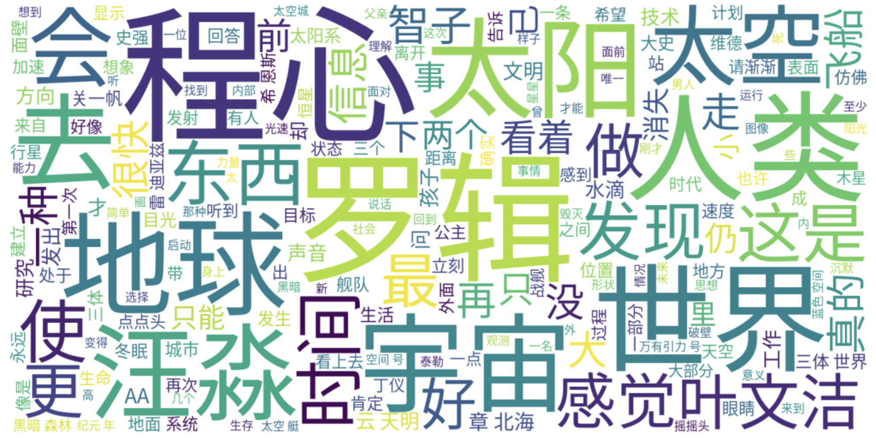
LabS04_2 - Word Cloud Chinese
Refer to the code: LabS04_2_WordCloudCN

Slide 12
Unstructured data in 1620
Which plays of Shakespeare contain the words Brutus AND Caesar but NOT Calpurnia?
One could grep all of Shakespeare’s plays for Brutus and Caesar, then strip out lines containing Calpurnia?
Why is that not the answer?
  Slow (for large corpora)
  NOT Calpurnia is non-trivial
  Other operations (e.g., find the word Romans near countrymen) not feasible
  Ranked retrieval (best documents to return)
    Later lectures
Notes:
Grep is line-oriented; IR is document oriented.

Slide 13
Term-document incidence matrices
1 if play contains word, 0 otherwise
Brutus AND Caesar BUT NOT Calpurnia

Slide 14
Incidence vectors
So we have a 0/1 vector for each term.
To answer query: take the vectors for Brutus, Caesar and Calpurnia (complemented) ➔ bitwise AND.
  110100 AND 110111 AND 101111 = 100100

Slide 15
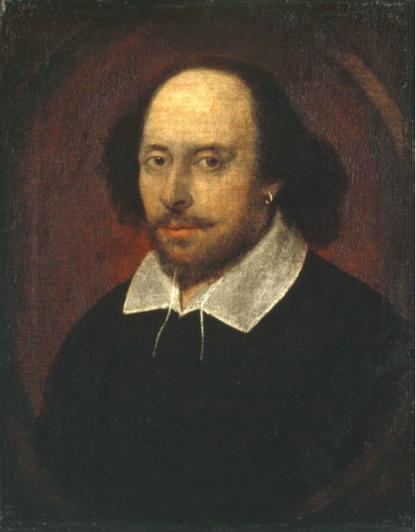
Answers to query
Antony and Cleopatra, Act III, Scene ii
Agrippa [Aside to DOMITIUS ENOBARBUS]: Why, Enobarbus,
When Antony found Julius Caesar dead,
He cried almost to roaring; and he wept
When at Philippi he found Brutus slain.
Hamlet, Act III, Scene ii
Lord Polonius: I did enact Julius Caesar I was killed i’ the
Capitol; Brutus killed me.
Notes:
Wikimedia commons picture of Shake

Slide 16
Bigger collections
Consider N = 1 million documents, each with about 1000 words.
Avg 6 bytes/word including spaces/punctuation
  6GB of data in the documents.
Say there are M = 500K distinct terms among these.

Slide 17
Can’t build the matrix
500K x 1M matrix has half-a-trillion 0’s and 1’s.
But it has no more than one billion 1’s.
  matrix is extremely sparse.
What’s a better representation?
  We only record the 1 positions.
Why?

Slide 18
Inverted index
For each term t, we must store a list of all documents that contain t.
  Identify each doc by a docID, a document serial number
Can we used fixed-size arrays for this?
Brutus
1
2
4
11
31
45
173
174
Caesar
1
2
4
5
6
16
57
132
Calpurnia
2
31
54
101
What happens if the word Caesar is added to document 14?

Slide 19
Inverted index
We need variable-size postings lists
  On disk, a continuous run of postings is normal and best
  In memory, can use linked lists or variable length arrays
    Some tradeoffs in size/ease of insertion
Posting
Brutus
1
2
4
11
31
45
173
174
Caesar
1
2
4
5
6
16
57
132
Calpurnia
2
31
54
101
Dictionary
Postings
Sorted by docID (more later on why).
Notes:
Linked lists generally preferred to arrays
Dynamic space allocation
Insertion of terms into documents easy
Space overhead of pointers

Slide 20

Inverted index construction
Documents to
be indexed
Friends, Romans, countrymen.
Tokenizer
Token stream
Friends
Romans
Countrymen
Linguistic modules
Modified tokens
friend
roman
countryman
Indexer
friend
2
4
roman
1
2
Inverted index
countryman
13
16
Notes:
Document icons from free icon set: http://www.icojoy.com/articles/44/

Slide 21
Initial stages of text processing
Tokenization
  Cut character sequence into word tokens
    Deal with “John’s”, a state-of-the-art solution
Normalization
  Map text and query term to same form
    You want U.S.A. and USA to match
Stemming
  We may wish different forms of a root to match
    authorize, authorization
Stop words
  We may omit very common words (or not)
    the, a, to, of

Slide 22
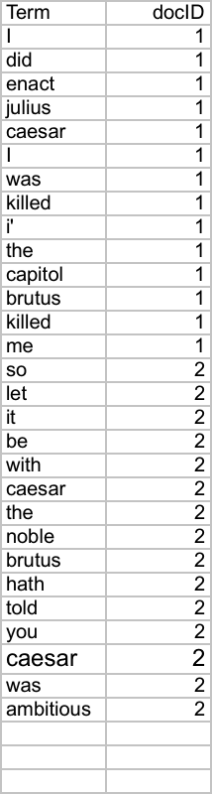
Indexer steps: Token sequence
Sequence of (Modified token, Document ID) pairs.
Doc 1
Doc 2
I did enact Julius
Caesar I was killed
i’ the Capitol;
Brutus killed me.
So let it be with
Caesar. The noble
Brutus hath told you
Caesar was ambitious

Slide 23
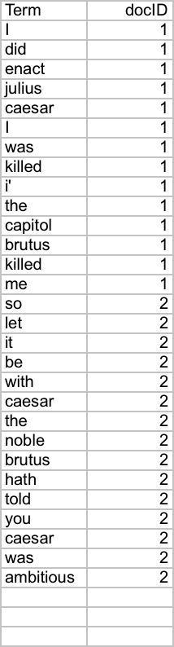
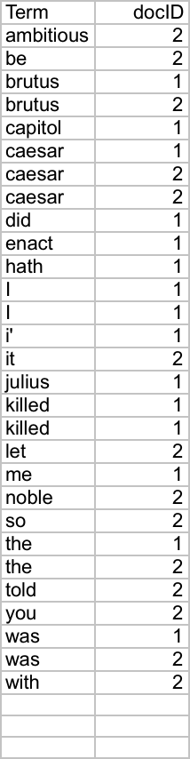
Indexer steps: Sort
Sort by terms
  And then docID
Core indexing step

Slide 24
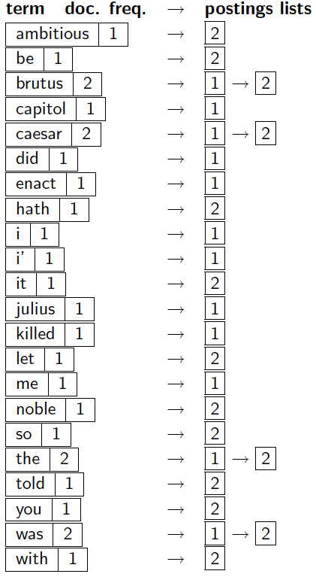
Indexer steps: Dictionary & Postings
Multiple term entries in a single document are merged.
Split into Dictionary and Postings
Doc. frequency information is added.
Why frequency?
Will discuss later.

Slide 25
Where do we pay in storage?
Lists of docIDs
Terms and counts
Critical Thinking:
How to write a pyspark program that will construct an inverted index described in this page?

Slide 26
The index we just built
How do we process a query?
  Later - what kinds of queries can we process?
Our focus

Slide 27
Query processing: AND
Consider processing the query:
  Brutus AND Caesar
  Locate Brutus in the Dictionary;
    Retrieve its postings.
  Locate Caesar in the Dictionary;
    Retrieve its postings.
  “Merge” the two postings (intersect the document sets):
2
4
8
16
32
64
128
Brutus
1
2
3
5
8
13
21
34
Caesar

Slide 28
The merge
Walk through the two postings simultaneously, in time linear in the total number of postings entries
2
4
8
16
32
64
128
Brutus
1
2
3
5
8
13
21
34
Caesar
2
8

Slide 29
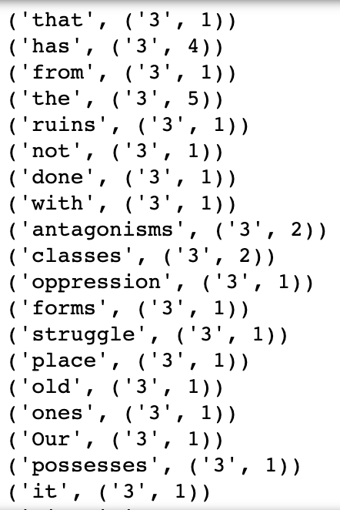
LabS04_3 - Inverted Index
Refer to code: LabS04_3_InvIndex

Slide 30
Inverted Index and Term Frequency
Inverted Index is also an essential part of the TF-IDF (Term Frequency-Inverse Document Frequency) algorithm
The first part of TF-IDF is similar as inverted index
We will learn TF-IDF in the next chapter

Slide 31
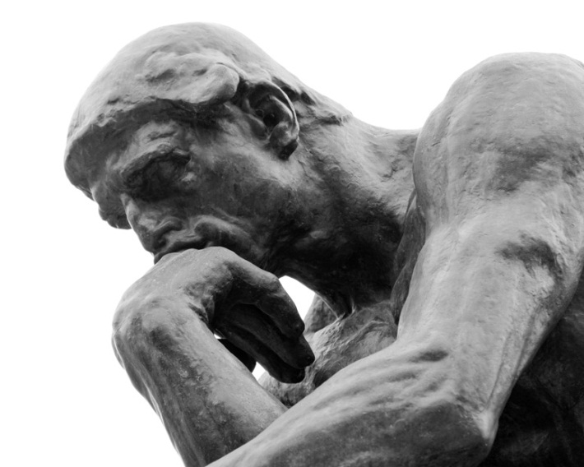
Questions?

